Slide 1
Implementation of Uninformed Search

Slide 2
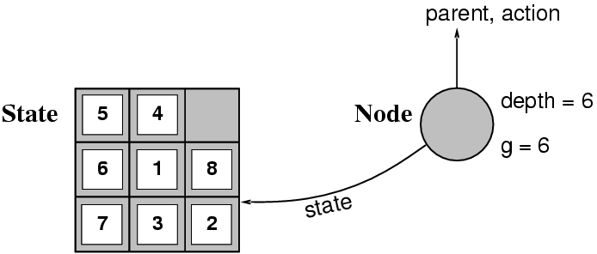
Implementation: STATES vs. NODES
A state is a (representation of) a physical configuration
A node is a data structure constituting part of a search tree includes state, parent node, action, path cost g(x), depth
The Expand function creates new nodes, filling in the various fields and using the SuccessorFn of the problem to create the corresponding states.

Slide 3
Infrastructure of Search Algorithms
Search algorithms require a data structure to keep track of the search tree that is being constructed.
For each node n of the tree, we have a structure that contains four components:
n.STATE: the state in the state space to which the node corresponds;
n.PARENT: the node in the search tree that generated this node;
n.ACTION: the action that was applied to the root to generate the node;
n.PATH-COST: the cost, traditionally denoted by g(n), of the path from the initial state to the node, as indicated by the parent pointers.

Slide 4
Queue Functions
The fringe is implemented as a queue
MAKE_QUEUE(element,…): makes a queue with the given elements
EMPTY?(queue): checks whether queue is empty
FIRST(queue): returns 1st element of queue
REMOVE_FIRST(queue): returns FIRST(queue) and removes it from queue a.k.a POP(queue)
INSERT(element, queue): add element to queue a.k.a. PUSH(element,queue)
INSERT_ALL(elements,queue): adds the set elements to queue and return the resulting queue
4

Slide 5
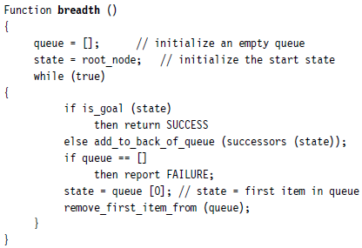
Implementing BFS

Slide 6
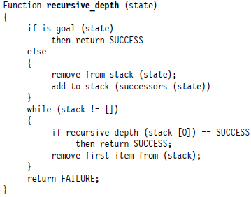
Implementing Recursive DFS

Slide 7
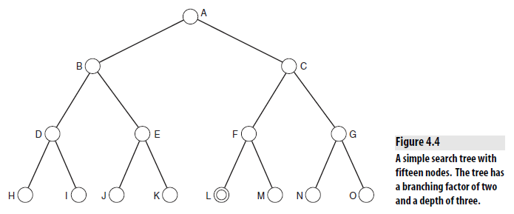

Slide 8
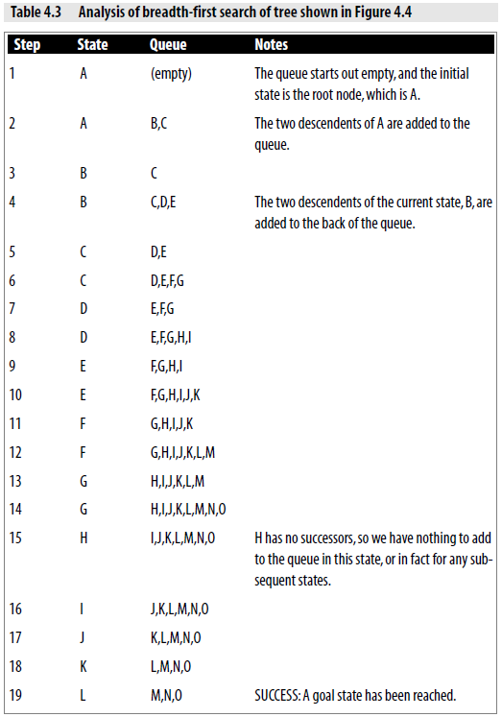

Slide 9
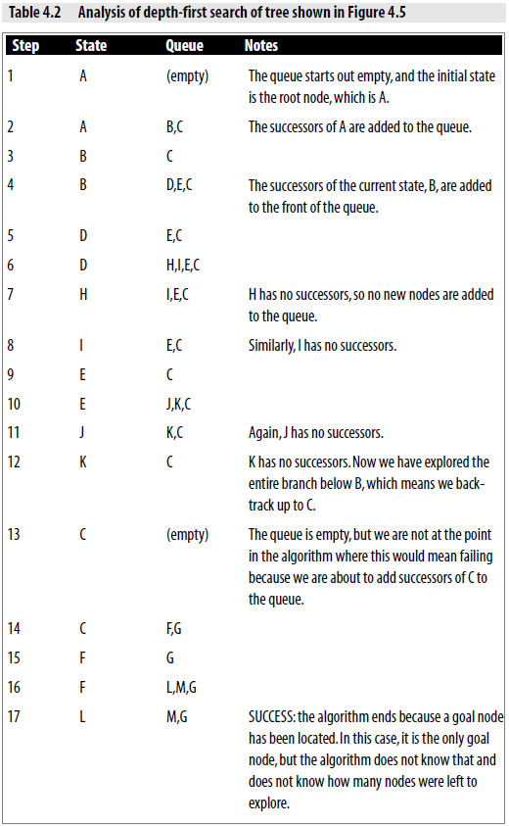

Slide 10
Map searching
Implementation in Python

Slide 11
Breadth First Search
a
G
b
c
e
d
f
S
h
p
r
q

Slide 12
Breadth-First Search
a
G
The root node is expanded first, then all the successors of the node are expanded next, then their successors, and so on.
Strategy: expand a shallowest node first
Implementation: Fringe is a FIFO queue
c
b
d
e
f
S
h
p
q
r
S
d
e
p
Search
Tiers
b
c
e
h
r
q
a
a
h
r
p
q
f
p
q
f
q
c
G
q
c
G
a
a

Slide 13
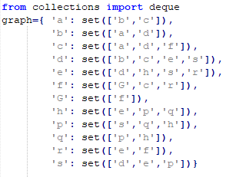
Map Searching – Implementation

Slide 14
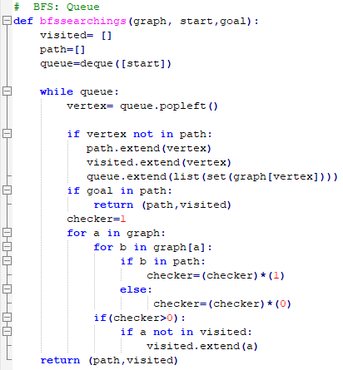

Map Searching – Implementation

Slide 15
Depth-First Search
a
G
a
Strategy: expand a deepest node first
Implementation: Fringe is a LIFO stack
c
b
c
b
e
d
e
d
f
f
S
h
h
p
p
r
q
r
q
S
d
e
p
b
c
e
h
r
q
a
a
h
r
p
q
f
p
q
f
q
c
G
q
c
G
a
a

Slide 16
Missionaries and Cannibals
Implementation in Python

Slide 17
Missionaries and Cannibals
Three missionaries and three cannibals are on one side of a river, with a canoe. They all want to get to the other side of the river. The canoe can only hold one or two people at a time. At no time should there be more cannibals than missionaries on either side of the river, as this would probably result in the missionaries being eaten.

Slide 18
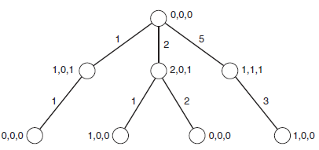
Missionaries and Cannibals
Representation
(3, 3, 1) → (0, 0, 0)
represents the number of cannibals, missionaries, and canoes
Number that is on one side is entirely dependent on the number that is on the other side,
we can in fact just show how many of each are on the finishing side, that is
starting state is represented as (0, 0, 0) and the goal state is (3, 3, 1)
An example of a state that must be avoided is
2, 1, 1
Actions?

Slide 19
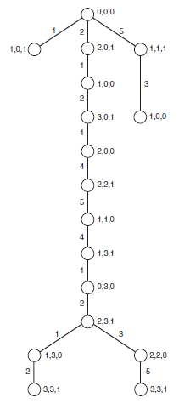
Missionaries and Cannibals

Slide 20
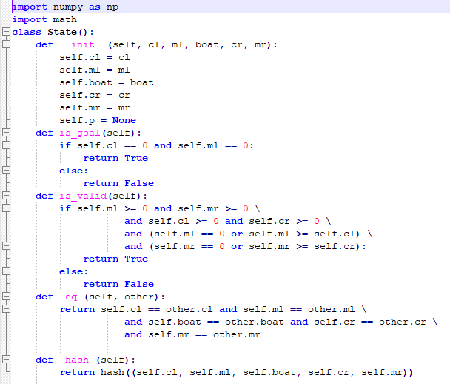
Missionaries and Cannibals – Implementation

Slide 21
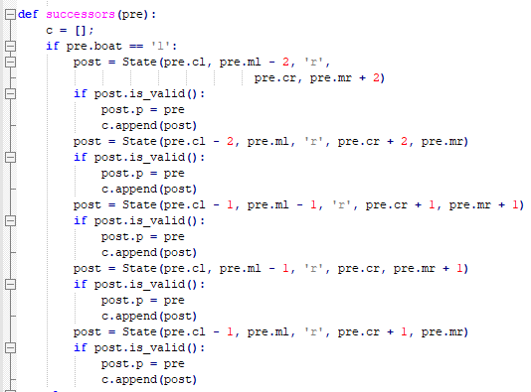
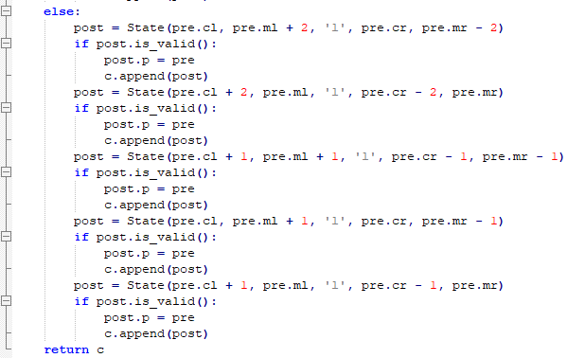
Missionaries and Cannibals – Implementation

Slide 22
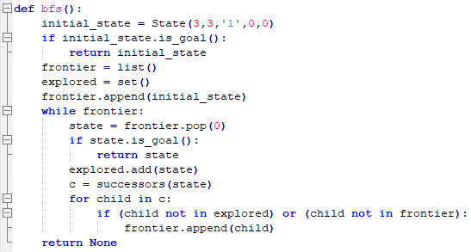
Missionaries and Cannibals – Implementation

Slide 23
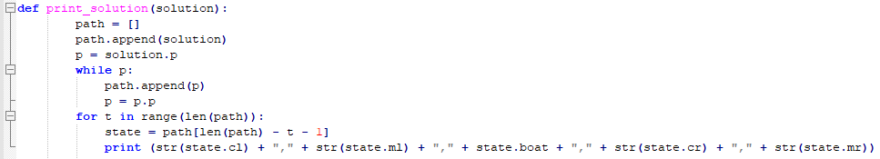
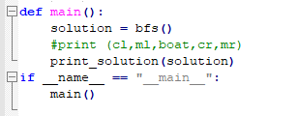
Missionaries and Cannibals – Implementation

Slide 24
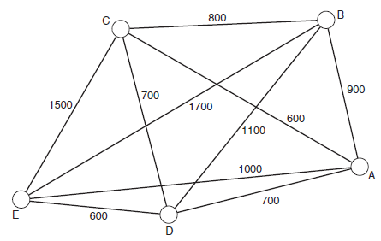
Traveling Salesman Problem
A salesman must visit each of a set of cities and then return home.
The aim of the problem is to find the shortest path that lets the salesman visit each city.
Let us imagine that our salesman is touring the following American cities:
A Atlanta
B Boston
C Chicago
D Dallas
E El Paso

Slide 25
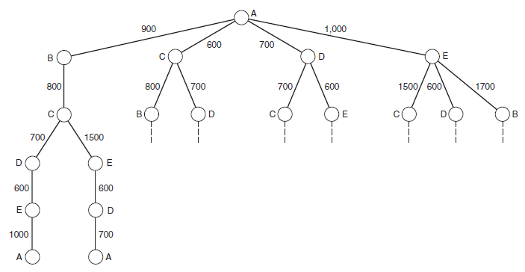
Traveling Salesman Problem (TSP)

Slide 26
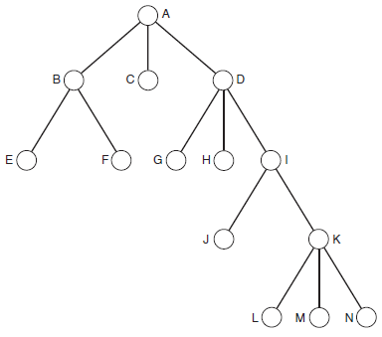
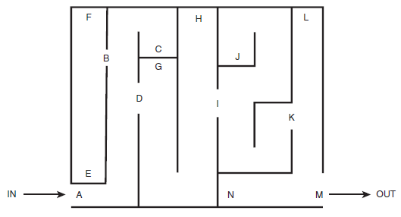
Maze

